Slide 1


COMMUNITY RADIO HISTORY AND ROLE
COMMUNITY MEDIA SUSTAINABILITY CONSULTATIVE CONFERENCE: 13 – 14 AUGUST 2020

Slide 2

About Us
The National Community Radio Forum (NCRF) is the national membership-based association of CRS’s and support service organisations. The NCRF exist to build an enabling environment for community radio establishment derived from principles of the Windhoek Declaration for Broadcasting.
Providing information and advice to the community radio sector and communities through consultation;
Setting standards for the sector and monitoring implementation;
Creating structures and systems that encourage community radio initiatives and stations to share experiences, skills, best practice models and resources;
Coordinating capacity building in the sector;
Lobbying and advocacy to promote the interests of the sector; and
Forging strategic alliances and partnerships with key stakeholders to facilitate delivery of services, resources, funding and support to the sector.
Since 1993
164 Member Stations
9 Provincial Structures

Slide 3
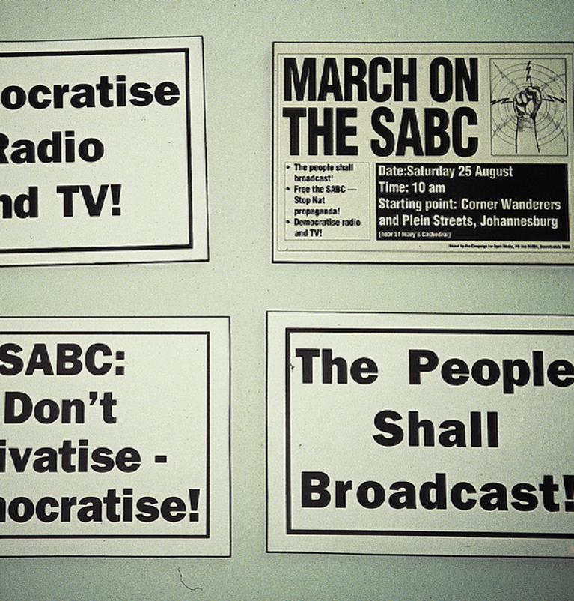
EARLY STEPS
The Beginning...
August 1990 saw a mass protest at the appointment of the Viljoen Task force into the future of broadcasting. The task force was seen as biased and not inclusive of progressive campaigners for broadcast reforms. Community radio was among these.

Slide 4
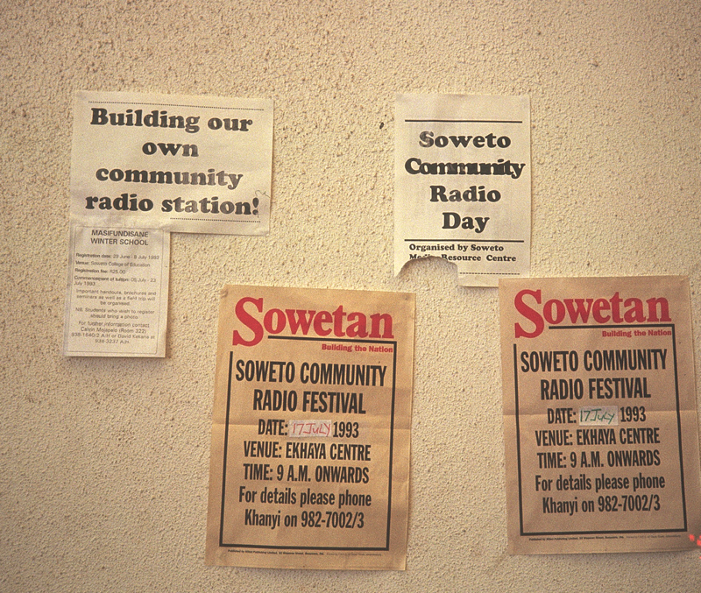
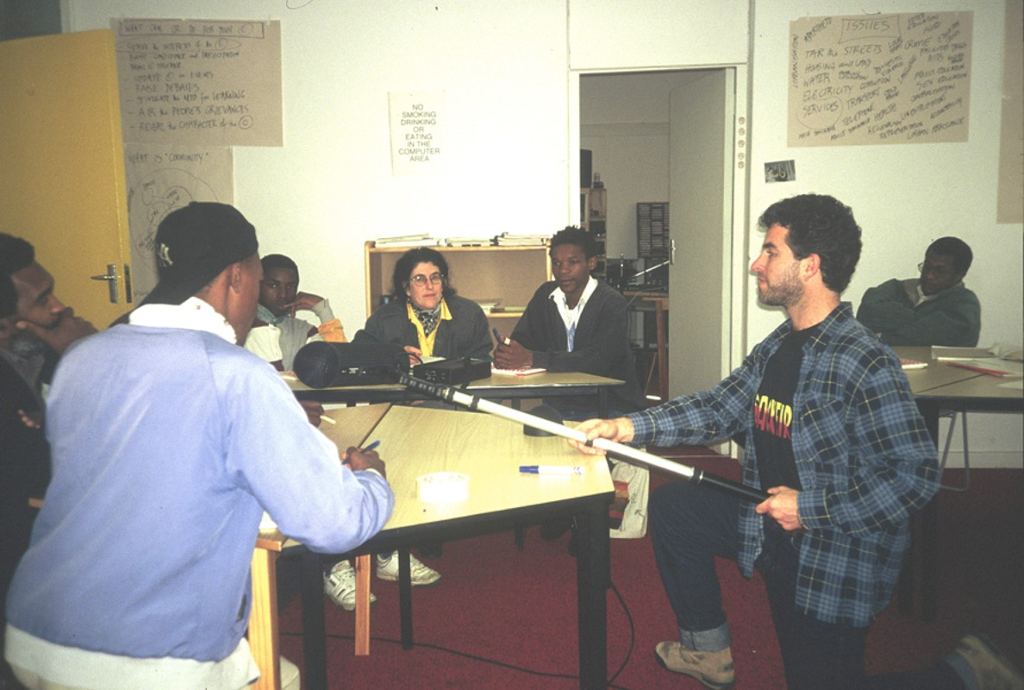
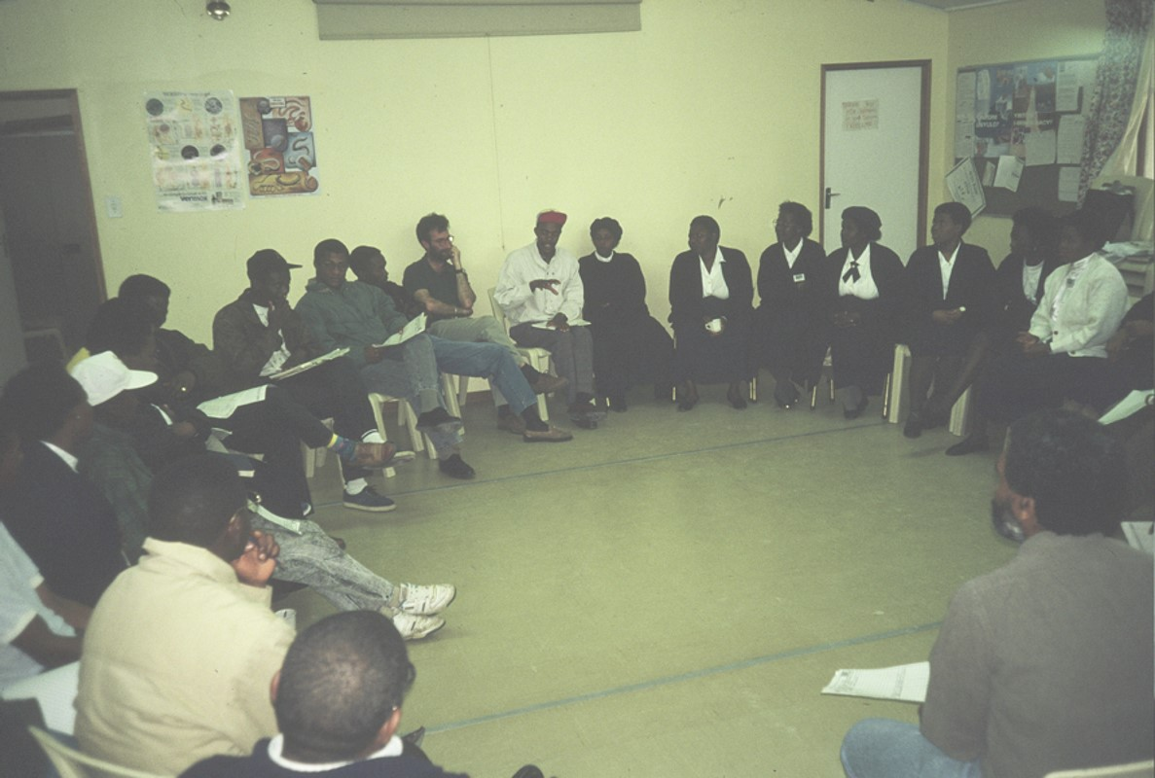
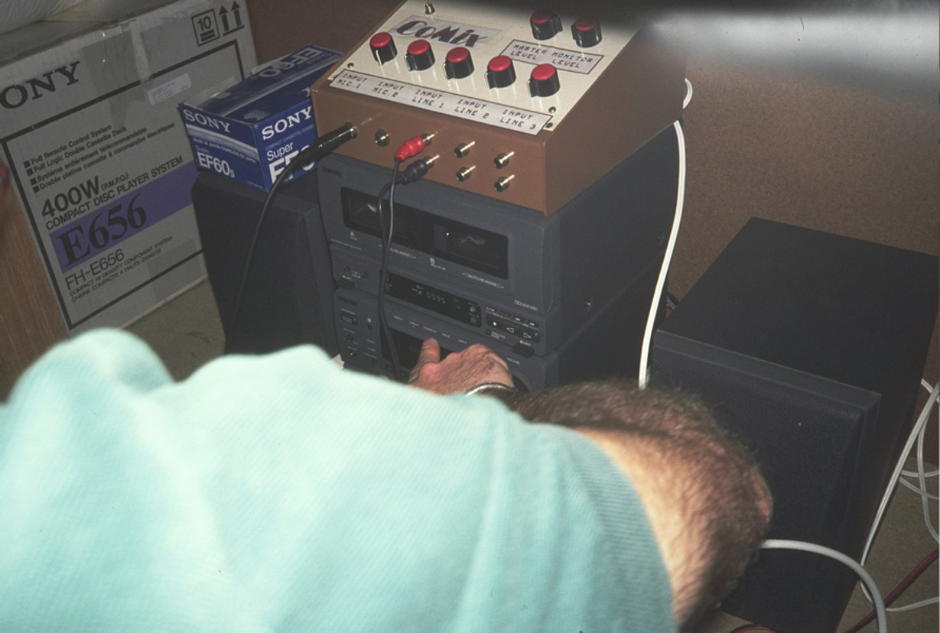
NCRF ARCHIVES
A narrowcast project outside the Ekhaya centre in Dube, Soweto. The aim was voter education. No formal radio equipment and no means to broadcast.
All over the country communities were working usually without adequate assistance.
Discussions in the background between donors and collaborators
Training sessions without equipment was a problem for years.
Bush Radio had a multi-faceted program that involved a training program run in conjunction with the IAJ and an open forum
Radio Zibonele was conducting a weekly community health broadcast from within Khayalitsha and was an important model for a community-based station.
Radio Petermaritsburg …….

Slide 5
Early successes
SOME KEY INDABAS WERE:
Rhodes University Media Policy workshop (90)
University of Bophuthatswana Media Policy Workshop (91)
Campaign for Open Media / IDASA Conference on the role and shape of media in the new South Africa (91)
SASPU Multi-media Mindblast
SASPU Free the Airwaves Campaign
SASPU Transformation of Campus Radio to Campus Community or COMMUNITY RADIO
Jabulani! Freedom of the Airwaves (91)
ANC Media Conference (91)
Free, Fair and Open Conference, UWC (92)
Chapmans Peak Conference (93)
North West Broadcasting Forum (Nov 94)
A series of indabas were arranged and enabled consistent participatory dialogue on the development of the sector, in the broader media environment. Many people were empowered.

Slide 6
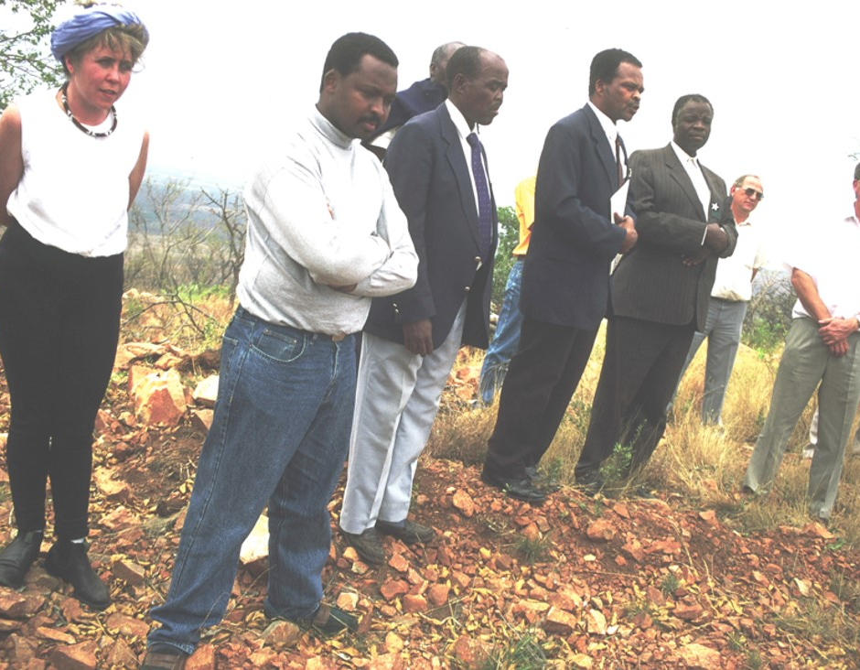
EARLY CHALLENGES
SENTECH was slow to democratise and its rates were far too high for the community radio sector. A review of signal distribution tariffs is still outstanding.
the transmitter to be located on the mountain overlooking the site for Moutse Community radio station.
Advertising revenue was slow in the early days because media planners were not familiar with ‘black’ areas. There was no audience measurement devices for community radio audiences.
Notes:
Arbitrary process of licensing - during the political negotiation process, against some negotiated way forward to level the playing field.
• Even after democracy, IBA’s operation outside of a policy framework - thereby no proper prioritisation of disadvantaged communities
Activists were absorbed into government and other industry players, weakening the NGO sector
Equally as we trained community radio people, they were poached by higher paying radio stations - public and commercial

Slide 7
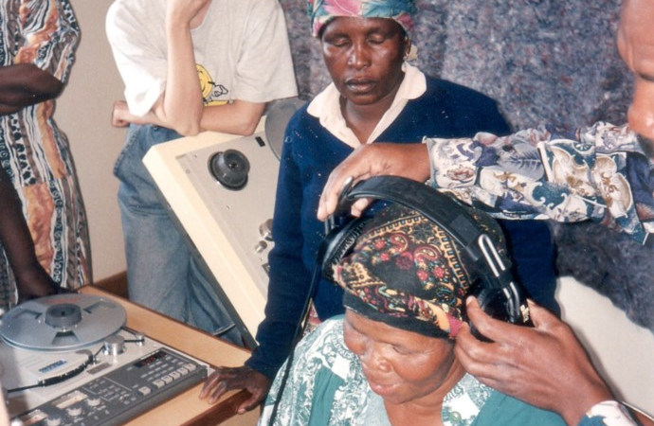
Mentorship & Training
Australian project provided early assistance to six community radio stations and the NCRF. Model included placement of trainers and mentors at stations.
Notes:
Other critical donors like Dutch based donors, Open Society Foundation South Africa, and others

Slide 8
A GROWING SECTOR
1993 and before – Radio Pietermaritzburg, UWC Radio (Bush Radio), Radio Zibonele and other initiatives
YEAR | NCRF MEMBERS | ON-AIR
1993 | 15 - 20 Projects | 0
1994 | 15 Aspirant Stations | 0
1995 | 38 | 15
1996 | 46 | 17
1997 | 50 | 40
2006 | 82 | 82
2020 | 164 | 164
2020 Total number of stations |  | 182
Notes:
Next time when there’s more time we will show how the audience grew from the first audience measurement to now.

Slide 9
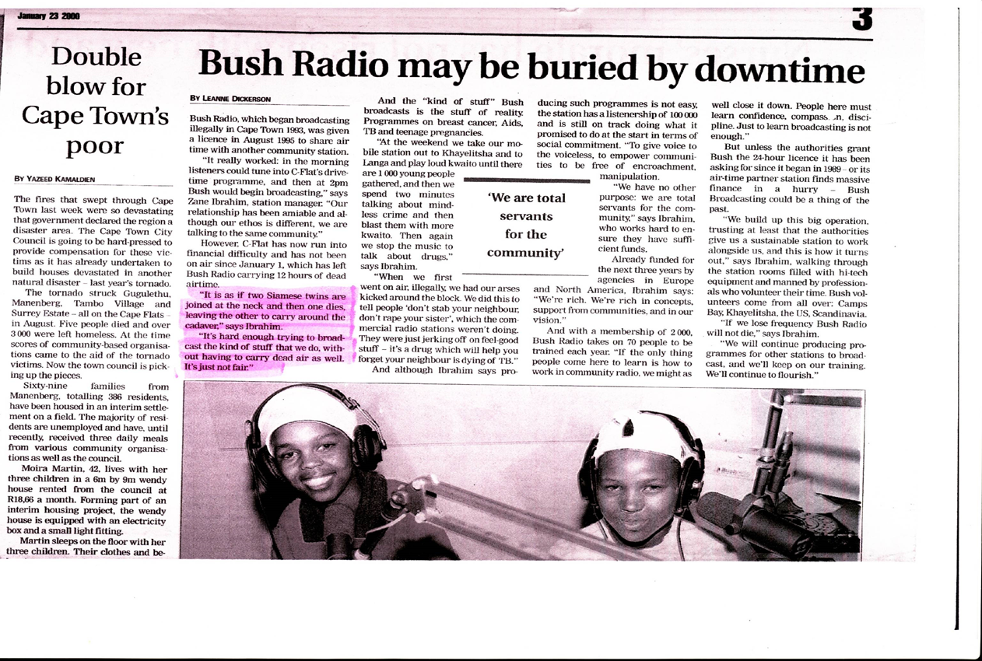
EARLY CHALLENGES
Frequency sharing provided a difficult solution to the lack of frequencies.
Notes:
The sector was vulnerable, no insurance, no proper equipment. The was greater need for resource lobby which later led to the formation of the MDDA.

Slide 10
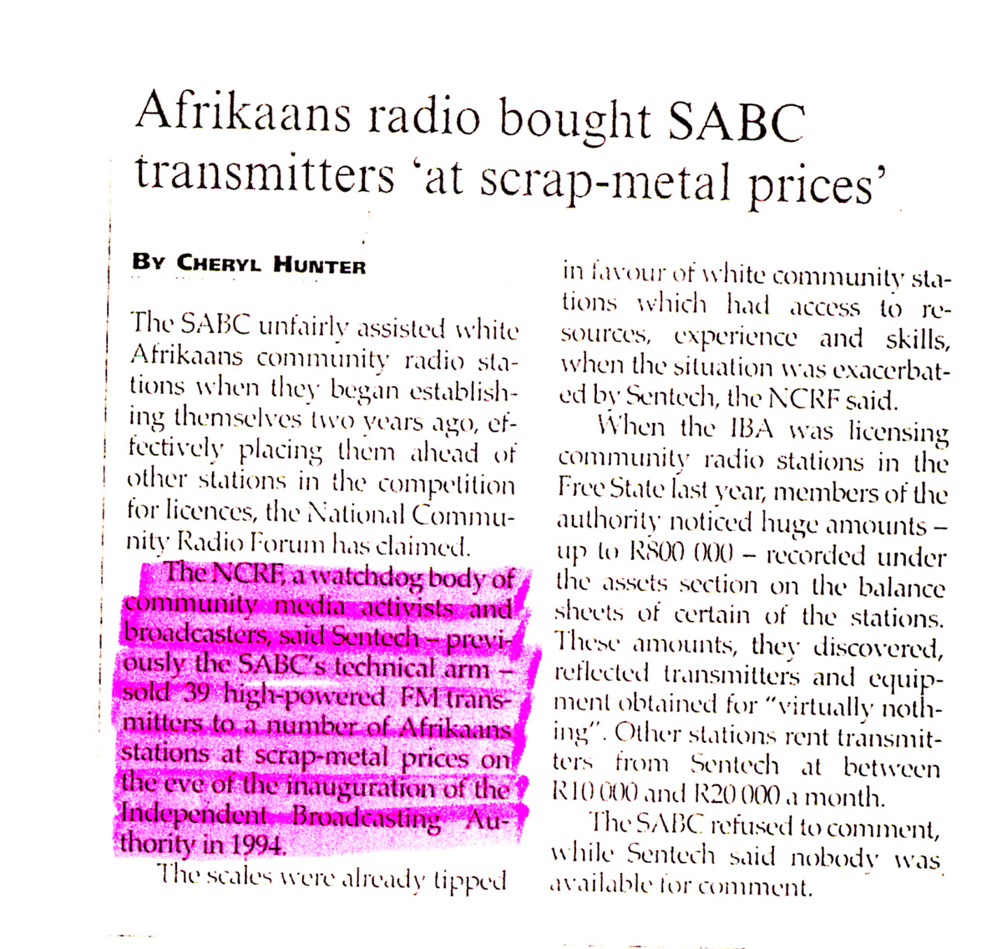
EARLY IRRITANTS
The sale of transmitters to right / white stations in the period before the 1994 election (by the SABC) at a time when disadvantaged communities were facing financial barriers to owning transmitters or paying SENTECH signal distribution fees

Slide 11
EARLY SUCCESSES
The campaign for independent broadcasting (Western Cape) and later the Campaign for Open Media involved key community radio pioneers.
The formation of Bush Radio as a spearhead for community radio was key to visibility, sustained training prior to broadcasting and for the rich debate and plans laid out at the regular Open Forums.
After licensing Radio Zibonele was able to broadcast without interference, proving feasibility and establishing an important model for grass roots participation.

Slide 12
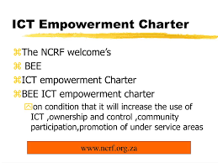
EARLY NCRF INDABAS
SUCCESSES
NCRF Healthy Station Workshop (Sept 95)
NCRF First Annual Congress (May 95)
NCRF Second Annual Congress (June 96)
NCRF Third Annual Congress (May 97)
NCRF Programming Summit (May 99)
NCRF Community Media Summit

Slide 13

EARLY SUCCESSES
Getting good people on the boards of the SABC and IBA Council, MDDA was crucial to working with those organisations
The altering of the ACT by the IBA to fast track community radio was an important gesture towards the need for grass roots communication
Successful lobbying for the removal of license fees for community radio
The reservation of frequency spectrum for future community
NCRF realizing its plans for the SACRIN project (a satellite info. Networking project)
STAKEHOLDERS

Slide 14
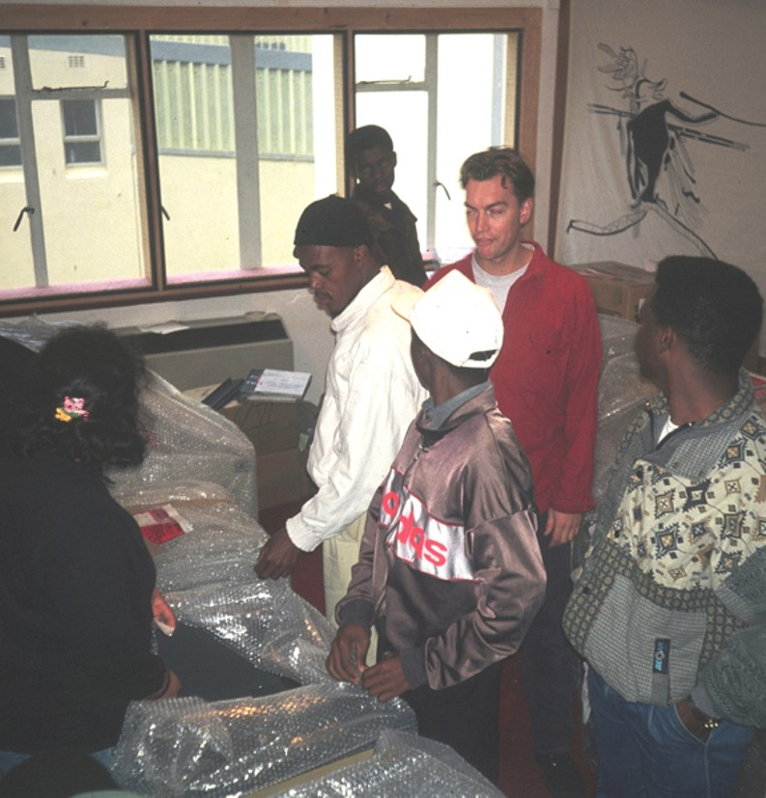
EARLY SUCCESSES
INTERNATIONAL SUPPORT
International solidarity was important, for example from AMARC
Early assistance from AusAID and FES was key to the start up of the sector. Their faith gave strength to the NCRF when other donors were skeptical and critical.

Slide 15
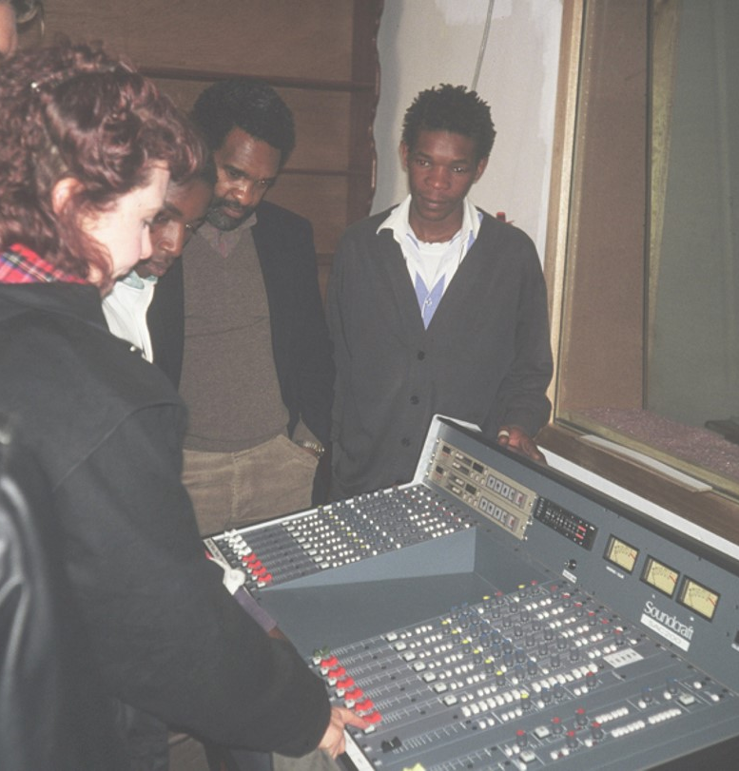
MORE SUPPORT
SA Government
IMDT
OSF
EMW
UNESCO
USAID/USIS and others….
DANIDA
Etc.

Slide 16
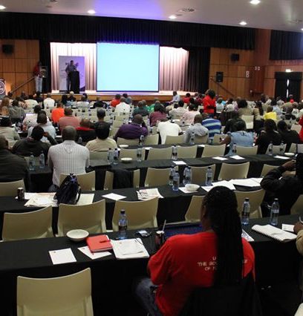
SUCCESSES
  The regulatory framework is clear
  An enabling support mechanism exist, in the form of MDDA
  DOC support for programming, infrastructure and training, GCIS prioritises community radio for advertising
  NEMISA offers state of the art training
  Local government support exists for community radio
Notes:
Later donors moved out and DOC introduced its community broadcast support program which had different aspect including content development, training, and infrastructure.

Slide 17

LEGISLATIVE FRAMEWORK
Legislative instruments in place
Prior to 1993 - no legislative and / or regulatory framework
1993 - IBA Act
1998 - White paper on broadcasting policy
2000 - ICASA Act
2002 - MDDA Act
2005 - Electronic Communications Act

Slide 18
TURBULANT RECENT HISTORY
DOC withdraws infrastructure and signal distribution support.
GCIS establishes Radio Unit and stops working through NCRF.
SENTECH switches off almost 20 stations for non-payment of signal distribution fees.
ICASA switches off 43 stations for defaulting on license renewal.
More training institutions fold (ABC Ulwazi, Media Training Centre for Health, etc)
Controversies at the MDDA

Slide 19
ONGOING CHALLENGES REMAIN
Capacity building, especially in the areas of corporate governance, management and financial management specifically, relevant programming, technical skills
Insufficient collaboration with Government to achieve social compact through usage of community radio for community mobilisation and driven development.
Sustaining skills and developing local “station based” skills developmentstrategies, plans and programmes on an ongoing basis.
Lack of access to broadband for the sector and the communities the serve.
Unintended Consequences of the EC Act on Community Radio Sector:
. Community Broadcasters not permitted any scope for late license renewal application when individual licensees are allowed.
. Community broadcasters not adequately prioritized to benefit from Universal Services and Access Fund.
Notes:
(Lack of proper support by the SITAs)

Slide 20





Thank You
Xola Nozewu
083 951 6160
manager@vukanifm.org
NCRF President

